Slide 1
Love and Forgiveness
Marshall Bowey & Jessica Macri

Slide 2
Contents
Introduction
Mise-en-scene
Language & structural choices
Attitudes and voices
Persuasive techniques
Cultural contexts
Positioning viewers
Anime films shaping responses
Conclusion

Slide 3
Introduction
Militarism is the belief that a country should maintain a strong military capability and be prepared to use it aggressively to defend or promote national interests. Howl’s moving castle, the anime film produced by Hayao Miyazaki in 2004 highlights love and forgiveness through symbolism, body language and gaze to position the viewer to feel as though they’re too embarking on a journey with the character’s romantic relationship. Love is a profoundly tender, passionate affection for another person. Forgiveness is an act of forgiving; state of being forgiven. Howl’s moving castle is a film about a young girl by the name of Sophie who is founded upon by a wizard known as Howl who protects her from the evil Witch of Waste that casted a spell upon Sophie, causing her to age into an old lady; with the determination of Sophie to find Howl she restores his heart, breaking the curse and returning all things back to the way they were. This anime film is set during World War 2, also known as the Second World War, a global war that lasted from 1939 to 1945. The film Howls Moving Castle, is a Dominant reading as the film is most common and widely-accepted interpretations of a given text. Hayao Miyazaki has demonstrated love and forgiveness through symbolism, body language and gaze to situate the viewer to feel empathy for the characters.

Slide 4
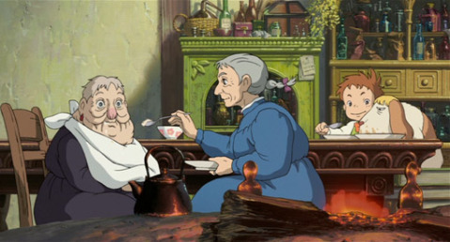
Mise-en-scene
love and Forgiveness

Slide 5
The ways ideas, attitudes and values are represented
The single biggest value throughout the whole movie is love. This has been represented through Sophie as she searches the valleys till she drops to find Howl, not just because she thought he could fix her, but because she loves him.
Sophie also shows love and compassion to almost everyone she comes across, such as the scarecrow, the dog and the young boy in Howls castle.

Slide 6
Analysing changing responses to texts overtime in different cultural contexts
Every society has expectations about how its members should and should not behave. A norm is a guideline or an expectation for behaviour. Each society makes up its own rules for behaviour and decides when those rules have been violated and what to do about it. Norms change constantly.
The biggest changes in culture from that era to now is the way that people dress, way we talk and technology of each era.

Slide 7
Critically examining how and why text position readers and viewers
This certain scene positions the viewer to feel empathy towards the witch of the waste as she has now lost everything and needs Sophie to care for her as illustrated in the scene.
this has been done as now the viewer can now relate to the character on a deeper level and connect with the film.

Slide 8
How anime film as a different text type shapes audience response
Mimetic and Diegetic effects are used to enhance the authenticity and believability within Howl's moving castle as well as to express Miyakaki's antiwar values and his dismissive attitudes towards warfare.

